Slide 1
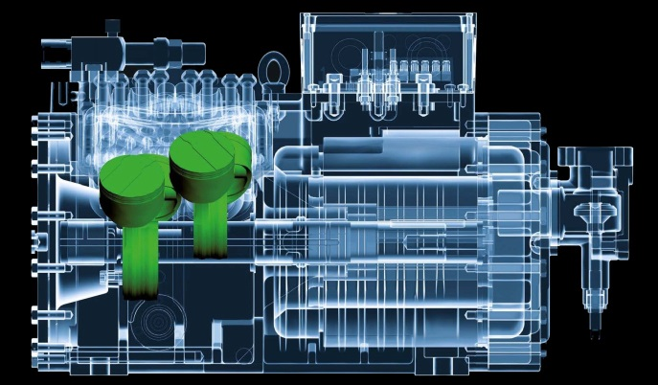
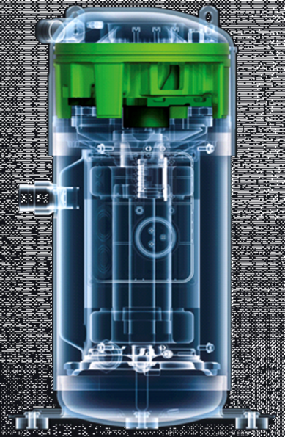
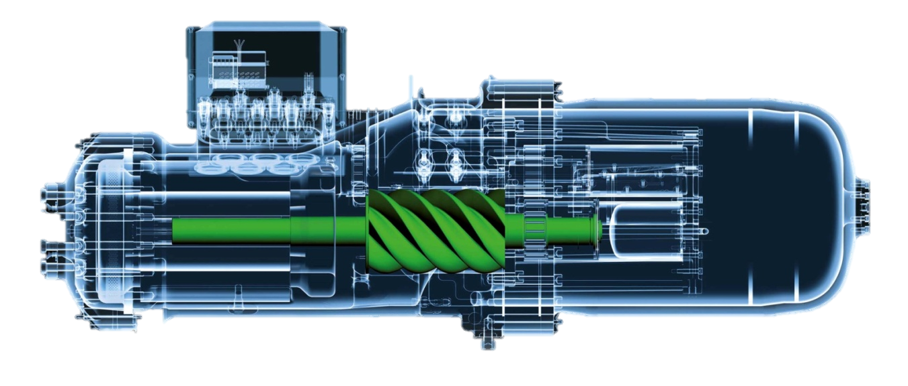
BITZER Compressor Nomenclature

Slide 2
GSD 6 / 8 - Nomenclature
1 | 2 | 3 | 4 | 5,6,7,8 | 9 | 10 | 11 | 12 | 13 | 14
Model | Config. | Refrigerant | Series | Cooling Capacity | Oil | Application | Connection | Nominal Voltage | Motor Protection | Design Variable
G | S | D | 8 | 0385 | V | A | B | 4 | 3 | 2
Model:
G: Scroll
Design Variable:
0: Original Design
1: w / Integral discharge check valve
2: design update
Configuration:
S: Single
T: Tandem
Y: Trio
Refrigerant:
D: HFC-410A
Motor Protection:
- : Not defined
1: SE-E1 Module (115/230V) w/ Phase-Rotation monitor
2: SE-B2 Module (24VAC) Installed
3: SE-B3 Module (115/230V ) Standard
4: SE-E1 Module (24VAC) w/ Phase-Rotation monitor
5 : DGTS Installed
6: SE-E1 Module (115/230V) w/ DGTS installed
7: SE-B2 Module (24VAC) w/ DGTS installed
8: SE-B3 Module (115/230V ) w/ DGTS installed
9: SE-E1 Module (24VAC) w/ DGTS installed
Series:
6: 6 Series
8: 8 Series
Capacity:
(kBtuh @ ARI)
6 Series
0120 (10t)
0137 (12t)
0154 (13t)
0182 (15t)
0235 (20t)
8 Series
0295 (25t)
0385 (32t)
0421 (35t)
0485 (40t)
Oil Charge:
V: PVE Oil
Application:
A: Air Cooled
W: Water Cooled (GSD8 only)
Voltage: (3Ph)
2: 208/230-60, 200/230-50
3: 380-60
4: 460-60, 400-50
5: 575-60, 500-50
Connection:
B: Brazed
R: Rotalock (GSD8 only)

Slide 3
ESH Scroll Series Nomenclature
1,2 | 3 | 4 | 5,6 | 7 | 8
Model | Config. | NH3 | Frame Size | Displ | Series
ES | H | 7 | 36 | Y | 4SU
Model:
ES: Standard
Configuration:
H: High Temperature
7:
Series
Displacement:
25,30,36,43
Oil Type:
Y: POE
Blank: AB
Voltage Code:
2SU: 208/230
4SU: 460
5SU: 575

Slide 4
CSH.3, CSW, HS Screw Series Nomenclature
1,2 | 3 | 4,5 | 6 | 7 | 8,9,10 | 11 | 12
Model | Config. | Frame Size | Displ | Series | Motor HP | Oil | Motor Code
CS | W | 75 | 7 | 3 | 90 | Y* | 4PU
Model:
CS: Screw
HS: Screw
Configuration:
H: High Condensing
W: Low Condensing
K: Med/High Temp
N: Low Temp
Frame Size:
HS: 53/64/74/85 CS: 65/75/85/95
*Oil Charge/Type:
Y: CSH/CSW with HFC POE 170 Oil
Y: CSW with R134A POE 170L Oil
If No “Y” in model number: CSH/CSW with R22 POE 320 Oil
Displacement:
4..11
Series:
1,3
Code for
Motor Size:
90: Horsepower
Oil Type:
Y: POE 170 Oil (CSH)
Y: POE 170L Oil (CSW)
Blank: POE 320 Oil (R22)
Voltage: (3Ph) UL
2NU: 208-230/460 (HS53 Only)
1PU: 200-60 (HS/CS65/75)
2PU: 208/230-60 (HS/CS65/75/85)
3PU: 380-60 (HS/CS65/75/85)(CS95 3DU)
4PU: 460-60 (HS/CS65/75/85)(CS95 4DU)
5PU: 575-60 (HS/CS65/75/85)(CS95 5DU)

Slide 5
CSV Screw Series Nomenclature
1,2 | 3 | 4 | 5 | 6 | 7,8 | 9 | 10 | 11
Model | Config. | Application | Displ | Series | Motor HP | Motor Type | Oil | Motor Code
CS | V | W | 2 | 5 | 90 | M* | Y | 4PU
Model:
CS: Screw
Configuration:
V: Variable Speed
Motor Code:
4AU: 380..480 volt / 3 / 50-60Hz
4MU: 380..480 volt / 3 / 50-60Hz
Application Range:
H: Optimized air cooled chillers –
heat pump applications
W: Optimized water cooled chillers
Oil Charge/Type:
Y: POE 170
Housing Size:
2..3
Motor*:
M: Permanent Magnet Motor
Inverter Size:
4…6
Motor Size:
125, 160, 200

Slide 6
OS Screw Series Nomenclature
1,2 | 3 | 4,5 | 6 | 7 | 8
Model | Config. | Frame Size | Displ | Series | Design
OS | K | 74 | 6 | 1 | K
1,2 | 3 | 4 | 5,6 | 7 | 8 | 9
Model | Config. | NH3 | Frame Size | Displ | Series | Design
OS | N | A | 85 | 6 | 1 | K
Model:
OS: Open Screw
Model:
OS: Open Screw
Configuration:
N: Low Temperature
K: Med/High Temperature
Configuration:
N: Low Temperature
K: Med/High Temperature
H: High Temperature (OS.A74)
Frame Size:
53,74,85
Displacement:
4..7
A:
NH3 Design
Series:
1
Frame Size:
53,74,85,95
Displacement:
4..10
Design:
K: Direct Coupling
Series:
1; Standard
2: High Temp (OS.A74)
Design:
K: Direct Coupling

Slide 7
Recip Series Nomenclature
1 | 2 | 3 | 4 | 5,6 | 7,8,9 | 10 | 11
Model | Config. |  | Lube | Motor HP | Voltage | Unloaders | Oil
4 | G | E | S | 30 | 2NU | 1* | D*
No. of Cylinders
2,4,6,8
Identification:
Bore and Stroke
*Bitzer US Only
Series:
Ecoline
Oil Lubrication:
S: Centrifugal CE1..CE4
Motor Size:
30: Horsepower
Oil:
D: Dry
Y: POE
Inverter (not shown):
.F3: Inverter size
Voltage: (3Ph) UL
2NU: 208/230-460
3PU: 380-60
4PU: 460-60
5PU: 575-60
Unloaders:
1..3

Slide 8
ECOSTAR Series Nomenclature
1 | 2 | 3 | 4 | 5 | 6 | 7 | 8 | - | 9 | 10 | 11
Model | Config. | Fans | Series | Comp. | HP | VFD | Oil | - | Future | Future | Future
LH | V | 7 | E | 4CE | 9 | F3 | Y | - | x | x | x
Model:
LH: Cond. Unit
Configuration:
V: Variable Speed
Fans:
5: 1 Fan
7: 2 Fan
Series:
E: ECOLINE
Compressor:
Displacement
Horse Power:
VFD:
F3 Only
Oil:
Y: BSE32
Notes:
Standardize on the slide title and format (above the green line)
Title line 1 - same name and format as presentation title on first slide except at 28pt
Title line 2 - same name and format as heading on first slide except at 28pt
Standardize on format of Specific slide title (below green line)
Specific slide title more detialed (i.e. product offering, highlights, piping
or
Standardize on the slide title and format (above the green line)
Title line 1 - same name and format as presentation title on first slide except at 28pt
Title line 2 - Specific slide title more detialed (i.e. product offering, highlights, piping
Standardize on format of Specific slide title (below green line)
Eliminate completely or use only when necessary to provide even more details
Bullet point levels
Standardize on format (ie. no bold)
Should we us 18pt instead of 20pt for spacing issues?

Slide 9
Varispeed Series Nomenclature
1 | 2 | 3 | 4 | 5 | 6 | 7 | 8
Model | Config. | Series | Lube | Motor HP | Inverter | Oil | Motor Code
4 | V | E | S | 10 | F4 | Y | 4SU
No. of Cylinders
2,4
Identification:
Bore and Stroke
Series:
Ecoline
Oil Lubrication:
S: Centrifugal
Voltage:
2NU: 208/230-460
4SU: 460-60
Motor Size:
3…20: Horsepower
Inverter:
3…4
Oil:
D: Dry
Y: POE

Slide 10
ACP Series Nomenclature
1,2,3 | 4,5,6,7 | 8 | 9 | 10 | 11 | 12 | 13 | 14
Model | Config. | Application | Qty | Config | Oil Cooling | Controller | Economizer | Starter Panel
SCP | 7472 | K | 2 | V | H | B | E | P
Model:
SCP: Screw Compressor Packages
ACP: Ammonia Compressor Packages
Starter Panel:
P: Soft-Starter or
VFD Panel Included
Size of Compressor Used:
5361, 7472, 8561
Unequal: “M”
(“SCP74M”)
Application Range:
N: Low temperature
K: Medium temperature
H: High temperature (74 series)
B: Booster application
Economizer:
E: Economizer Heat Exchanger Included
Number of Compressors:
Controller:
B: With Controller
Capacity Control Method:
V: Variable frequency
C: Capacity control (w/o VFD)
Oil Cooling Method:
H: Thermosiphon or Water/Brine via HX
L: Liquid Injection

Slide 11
Motor Compressor Assembly Nomenclature
1,2,3 | 4,5,6,7 | 8 | 9 | 10 | 11 | 12 | 13
Model | Config. | Application | Qty | Horsepower | Voltage and Motor Type | Terminal Box | Variant
S | D | 7471 | K | 100 | 2 | L | A
Model:
S: Screw Compressor
R: Recip Compressor
Drive Type:
D: Direct Drive
B: Belt Drive (Recip Only)
Compressor Model:
Example: 5341…7471
Starter Panel:
P: Soft-Starter or
VFD Panel Included
Application Range:
N: Low temperature
K: Med/High temperature
H: High temperature
B: Booster application
Economizer:
E: Economizer Heat Exchanger Included
Horsepower:
3 digits required
Controller:
B: With Controller
Voltage and Motor Type:
H:

